Slide 1



Supervised Fraud Model on Application Data
Team4:
Yifeng Wang, Di Zhang, Tianxing Wang
Yu Qin, Juxing Wang, Xiao Xiao

Slide 2
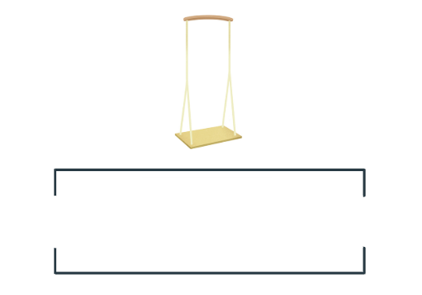
1
Executive Summary

Slide 3
Executive Summary
This project provides an analysis and evaluation of application data for detecting fraud using supervised machine learning methods.
The original data set contains 100,000 records of card transactions and has 10 variables of application details.
The general process of analysis follows data cleaning, expert variables creation, variable selection, applying fraud algorithms, calculating fraud scores and evaluating results.
Tools: R, Python, Excel
Algorithms: Decision Tree, Random Forest, Boosted Trees, and Logistic Regression.
Result: Boosting with 300 trees showed the best results. The Average FDR at 3% for out-of-time data is 49.30% average over 10 times.

Slide 4
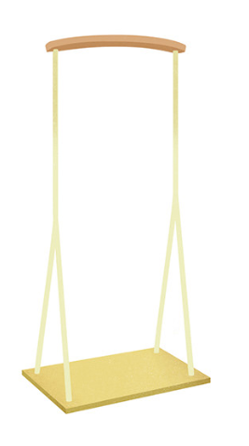
2
Description of Data

Slide 5
Description of Data
Description of dataset
This dataset contains 1000000 records of applications happened in 2016, and 14393 of them are fraud applications as their fraud_lable are marked as 1. There are 10 variables in the dataset: record, date, ssn, firstname, lastname, address, zip5, dob, homephone, fraud_lable.
Summary of categorical variables
Field | #values | %pupolated | #unique values
record | 1000000 | 100 | 1000000
date | 1000000 | 100 | 365
ssn | 1000000 | 100 | 835819
firstname | 1000000 | 100 | 78136
lastname | 1000000 | 100 | 177001
address | 1000000 | 100 | 828774
zip5 | 1000000 | 100 | 863348
dob | 1000000 | 100 | 42673
homephone | 1000000 | 100 | 28244
Fraud_lable | 1000000 | 100 | 2

Slide 6
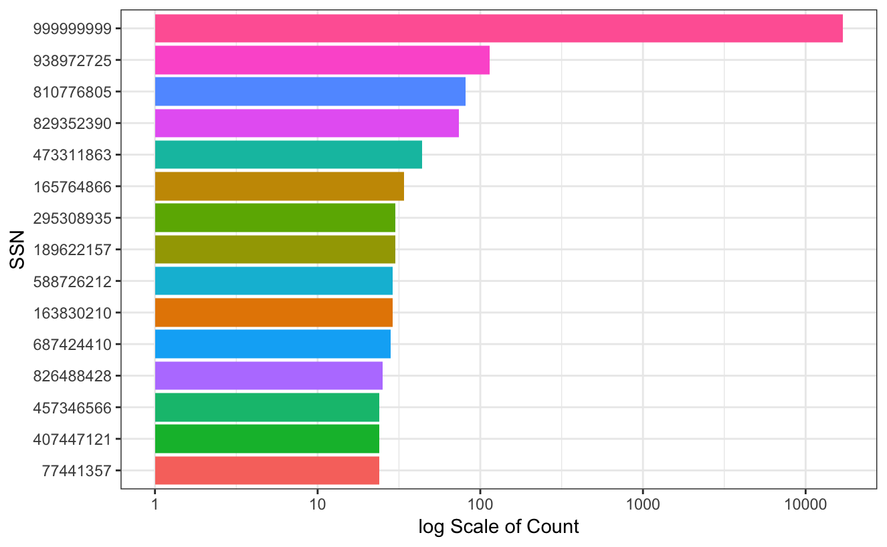
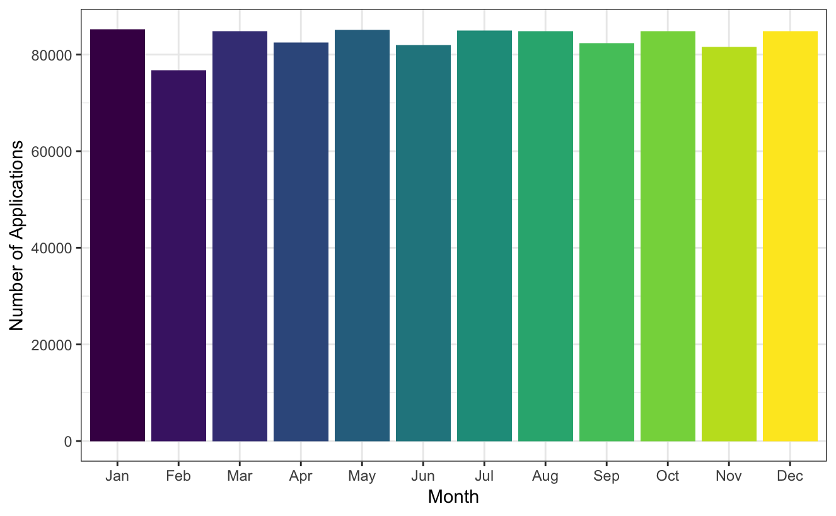
Description of Data
Date: When the application happened, so Date is categorical variable
SSN: Social Security Number, is special for everyone, so ssn is categorical variable
The chart below shows first 15 SSNs with highest times of application:
Distribution of application of month:
SSN 999999999 has the highest amount, but they are obviously made up by hand
There is no seasonality of month of the applications .

Slide 7
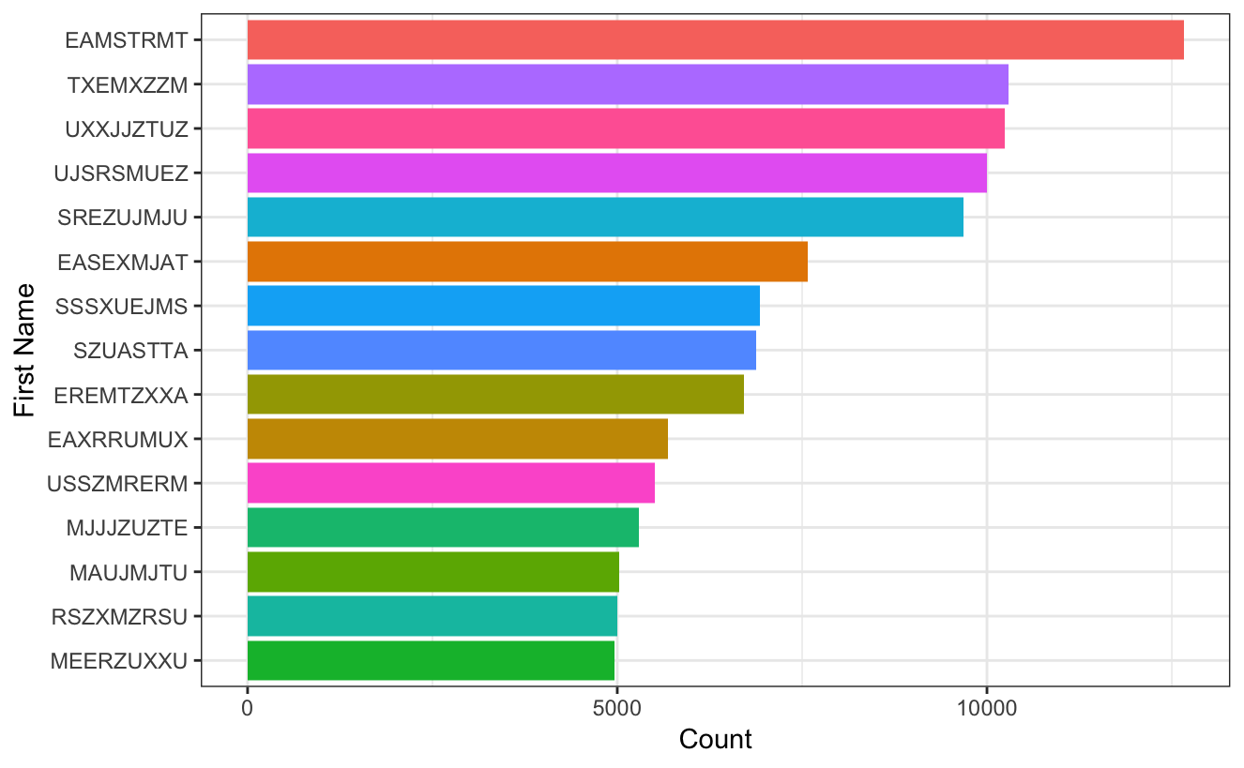
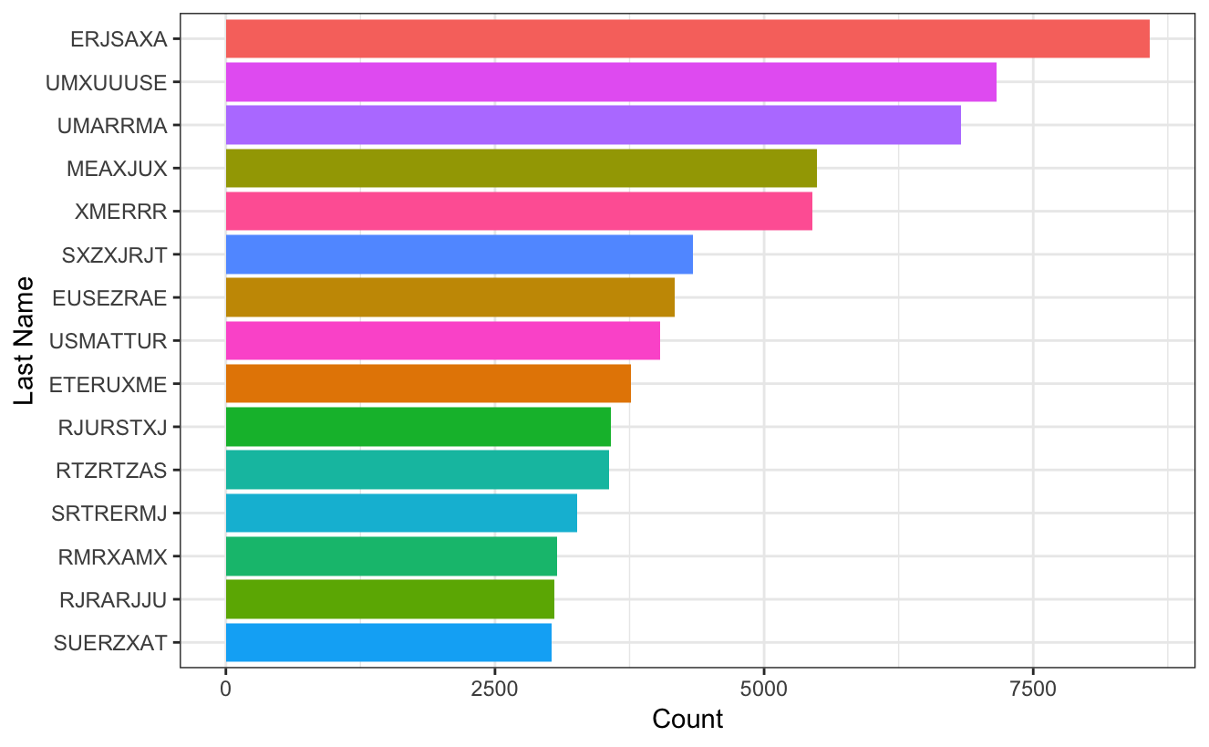
Description of Data
Firstname: the first name of applicant, so it should be categorical
Lastname: the last name of applicant, so it should be categorical
The chart below shows first 15 first names with highest times of application:
The chart below shows first 15 last names with highest times of application:
The first name appears most in all applications is EAMSTRMT.
The last name appears most in all applications is ERJSAXA

Slide 8
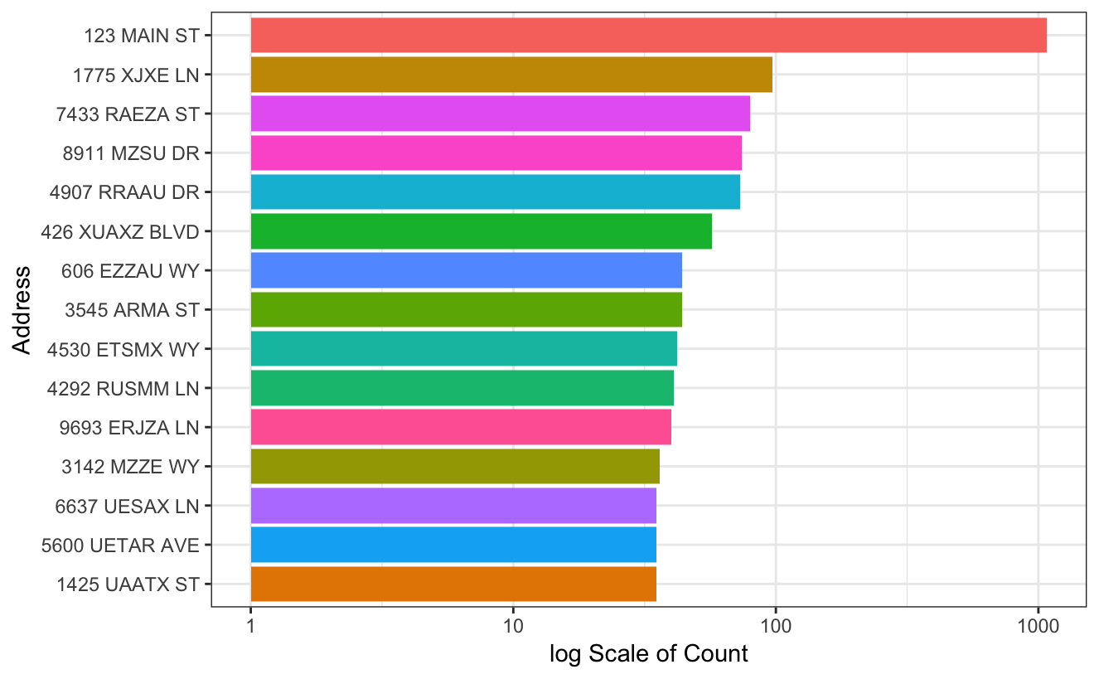
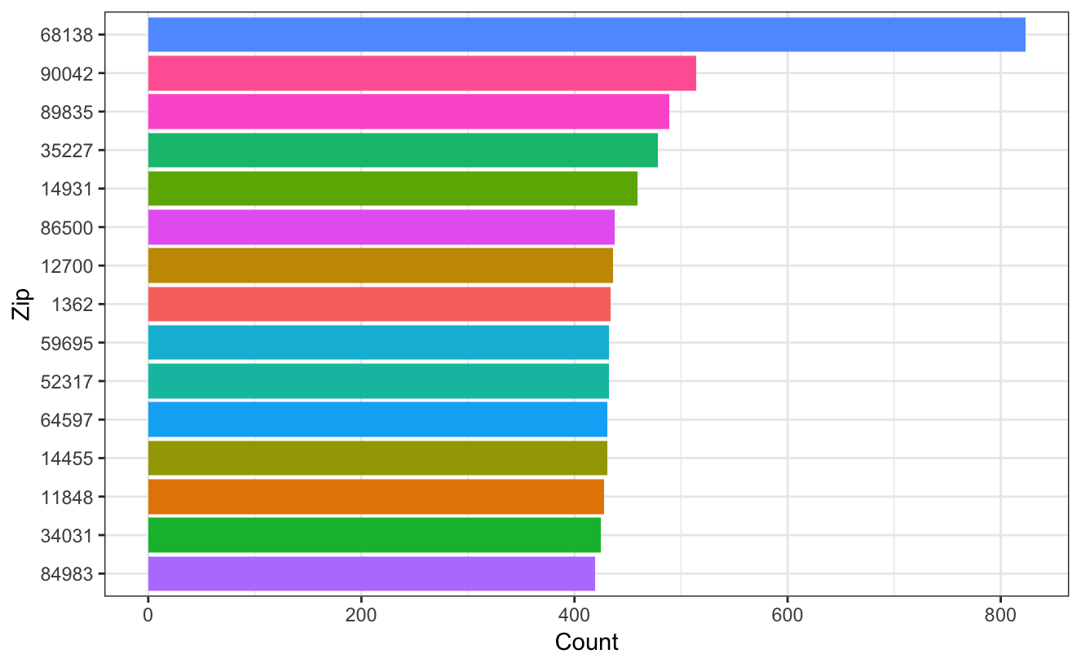
Description of Data
Address: the applicant’s address, so it is categorical
Zip5: the zip code of address of applications, so zip5 is a categorical variable
The chart below shows first 15 address with highest times of application:
The chart below shows first 15 zip codes with highest times of application:
Address “123 MAIN ST” has the highest amount, but it is obviously made up by hand.
Zip code 68138 has highest number of applications

Slide 9
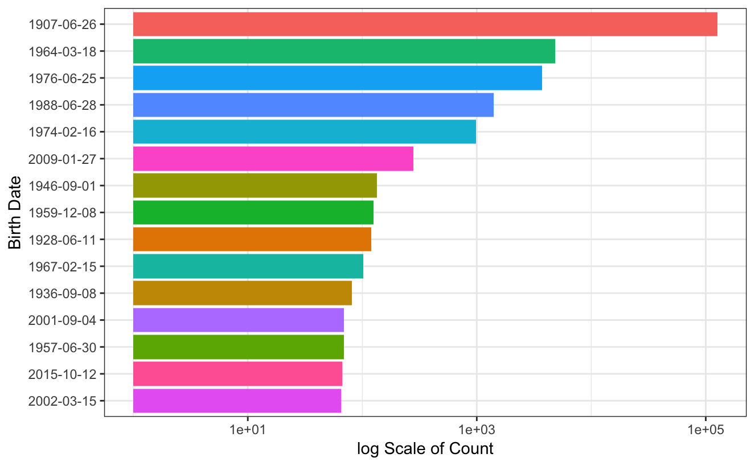
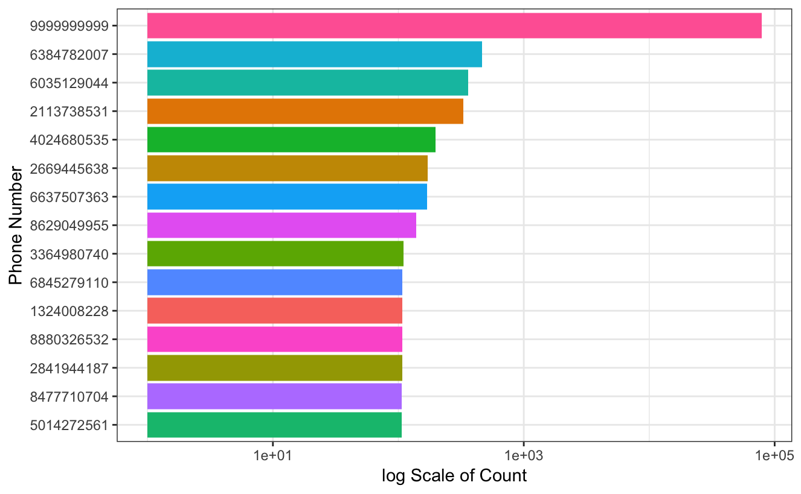
Description of Data
Dob: the birthdate of the applicant, so it is categorical variable
Homephone: the phone number of the application, so it is a categorical variable
The chart below shows first 15 dobs with highest times of application:
The chart below shows first 15 homephones with highest times of application:
Birthdate “1907-06-26” takes the most proportion, but this date is too far ago and obviously made up by hand
Phone number “9999999999” takes the most proportion, but the this phone number is obviously made up by hand

Slide 10
3
Data Cleaning

Slide 11
Data Cleaning
Method
SSN:
Replace all “999999999” as Record number
Address:
Replace all “123 MAIN ST” as Record number
Homephone:
Replace all “9999999999” as Record number
Birth of Date:
Replace all “19070626” as Record number
Use February 28 data to act as February 29 data
Reason
Record number are unique numbers for each records
There are already fraud labels in each record

Slide 12
4
Variable Creation

Slide 13
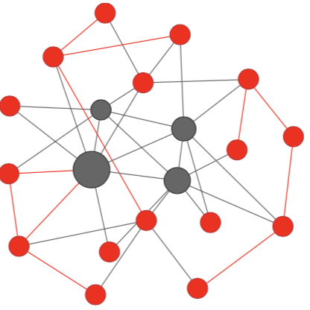
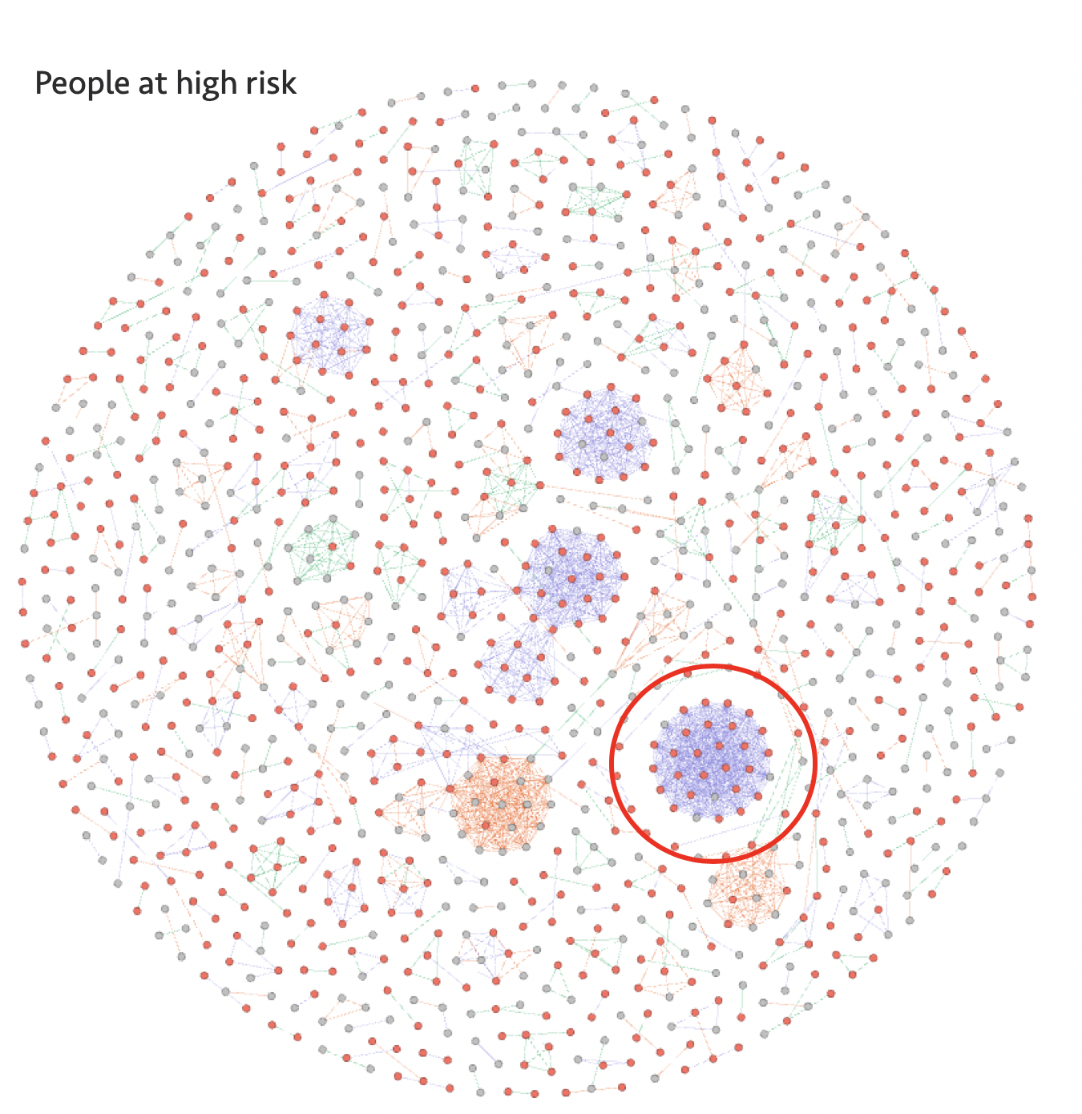
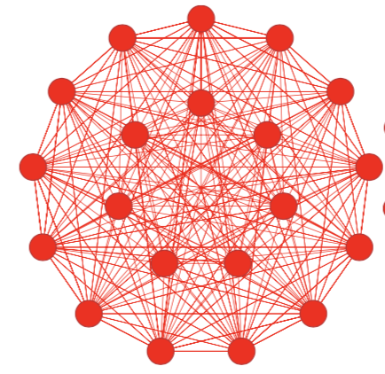
Variable Creation
Understand Fraud pattern
An individual fraudster has gotten a list of identity information (stolen, bought on internet…) and is going through this list applying for many products with many identities. He uses the victims’ core identity information (SSN, name, DOB) and his own contact information (address, phone number).
A victim’s identity was compromised in a data breach and core identity information is being used by many fraudsters.

Slide 14
Variable Creation
Process
New variable “name_dob: Concatenation of the existing variables “firstname”, “lastname” and “dob”.
New variable “address_zip5: Concatenation of the existing variables “address” and “zip5”.
combine each two entities from the following variables:
name, address-zip5, name-dob, name-address-zip5, name-dob, name-homephone, address-zip5-dob, address-zip5-homephone, dob-homephone, ssn-firstname, ssn-lastname, ssn-address, ssn-zip5, ssn-dob, ssn-homephone, ssn-name, ssn-address-zip5, ssn-name-dob

Slide 15
Variable Creation
Variable Composition
Since this analysis involves time, we chose several different time windows, 0,1, 3 ,7, 30, 90, 180 days. The rationale is to capture more fraudulent applications that might be different in those time windows.
Days since last seen: how many days since I last saw that entity or combination group
Velocity: number of records/entity seen over the past n days, n = 0, 1, 3, 7, 30,90,180
Velocity Change：number of records/entity seen over the past 1, days/ number of records/entity seen over the past 30,180 days
Risk table：ssn

Slide 16
5
Feature Selection

Slide 17
Feature Selection
Process
Filter(KS/FDR): 310->200
Wrapper(logistic regression): 200->100->50->25
KS and FDR
Prepare the dataset:
January – October Dataset: training and testing for modeling (training randomly choose 80%, testing is the remained 20%)
November – December Dataset: out of time data
Kolmogorov-Smirnov (KS)
Fraud Detection Rate (FDR)
Average KS and FDR score, sort from high to low

Slide 18
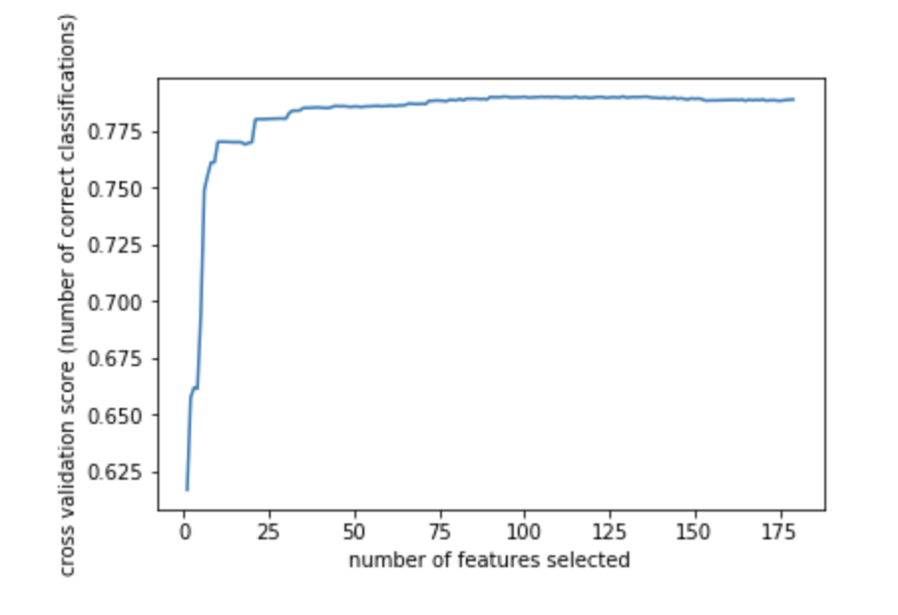
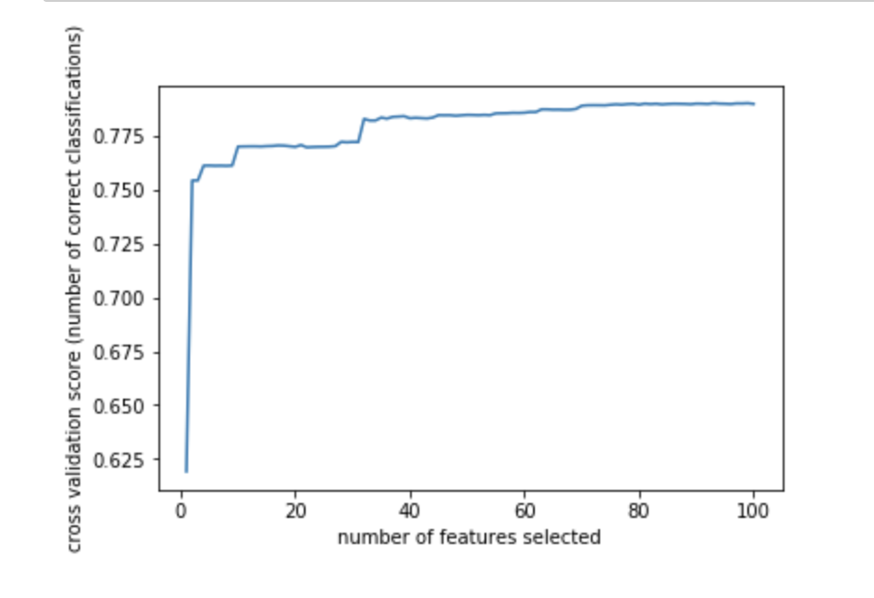
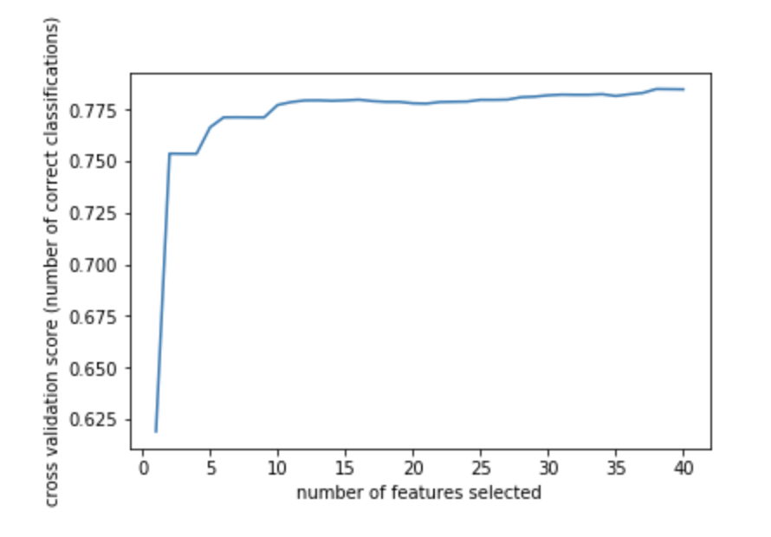
Feature Selection
Wrapper
Recursive feature elimination and cross-validated selection with logistics regression is used to get the feature rankings, then selecting best number of features.
200 -> 100
100 -> 50
50 -> 25

Slide 19
Feature Selection
Final 25 Variables
'address-zip5-homephone_count30_date', 'address-zip5_0_count_address-zip5_30_count_Ave', 'address-zip5_0_count_address-zip5_7_count_Ave', 'address-zip5_count0_date', 'address-zip5_count180_date', 'address-zip5_count1_date', 'address-zip5_count30_date', 'address-zip5_count3_date', 'address-zip5_count7_date', 'address-zip5_count90_date', 'address_0_count_address_180_count_Ave', 'address_0_count_address_30_count_Ave', 'address_0_count_address_7_count_Ave', 'address_count0_date', 'address_count180_date', 'address_count1_date', 'address_count30_date', 'address_count3_date', 'address_count7_date', 'address_count90_date', 'name-dob_count180_date', 'name-dob_count30_date', 'name-dob_count90_date', 'ssn-dob_count180_date', 'ssn-dob_count30_date'

Slide 20
6
Supervised Machine Learning Algorithms

Slide 21
Fraud Algorithms
Logistic Regression
Use sigmoid function to estimate the probability, and predict probability of each record.
Explain the relationship between one dependent binary variable and one or more nominal, ordinal, interval or ratio-level independent variables.
Decision Tree
Partitions the feature spaces into multiple high-dimensional boxes, and give predictions according to the majority vote in each box.
A single tree tend to have bias.
Criterion is gini impurity.

Slide 22
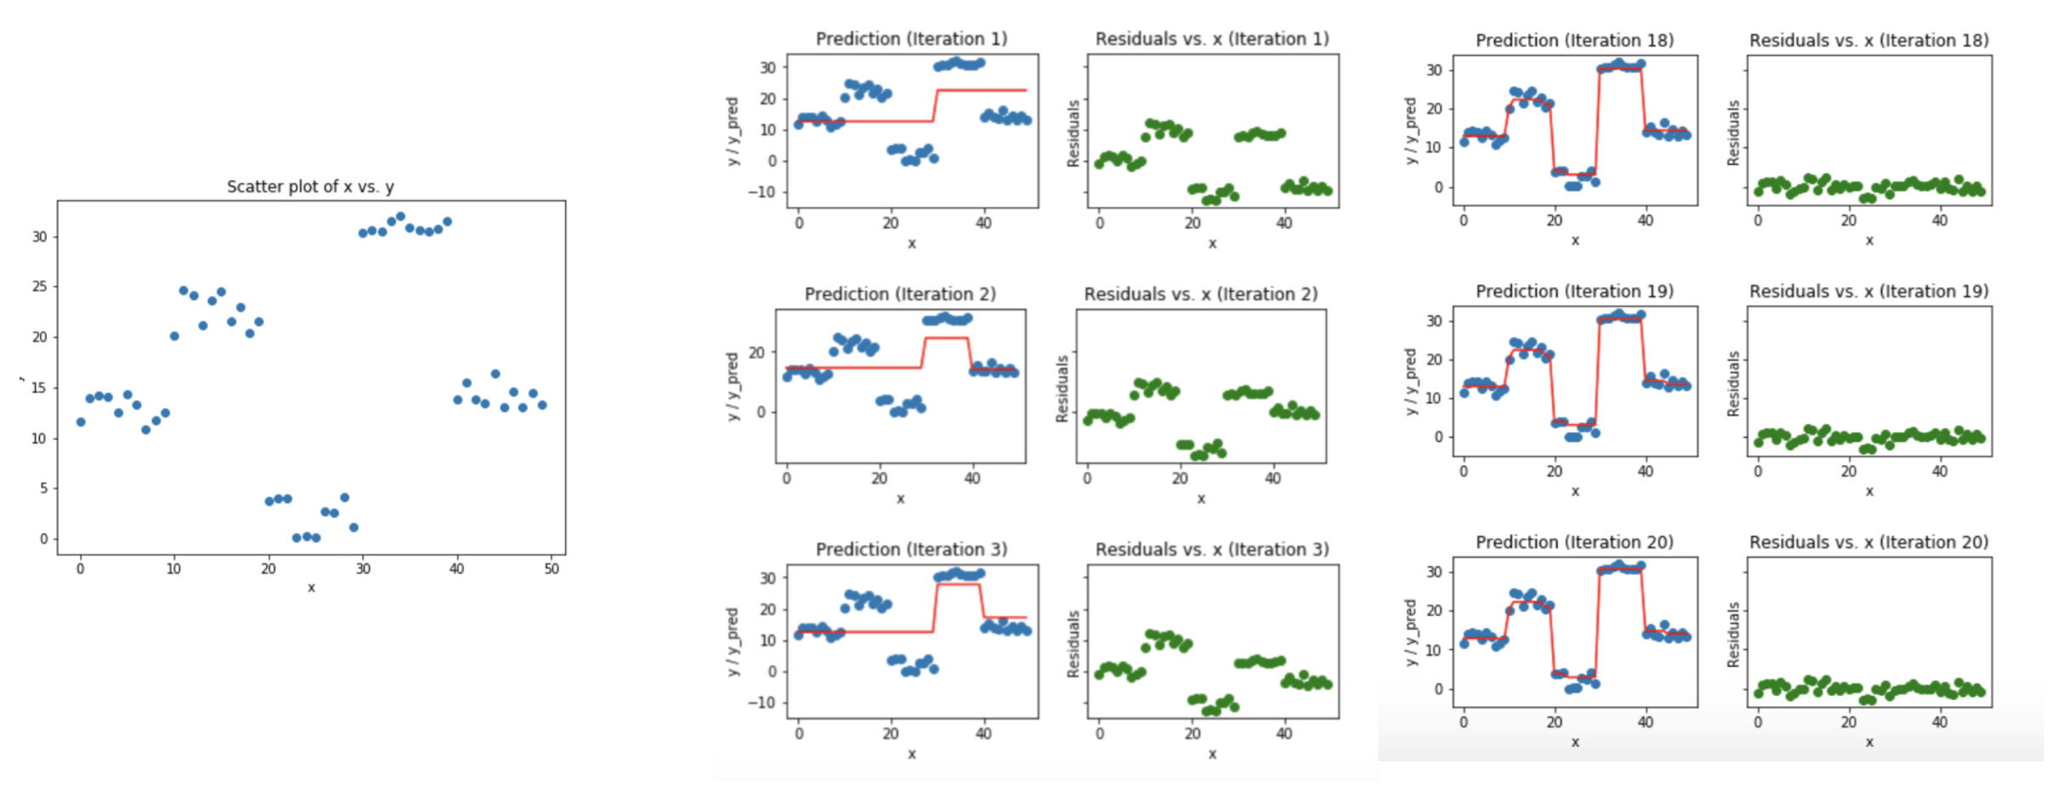
Fraud Algorithms
Boosted Tree
An ensemble classifier that combines predictions from multiple separate models.
It trains a number of “weak learners” in sequence to combine into one single strong learners.
The weak learners are constrained models. Each weak learner focus on learning from the mistakes of the one before it. The weight-age of each trained classifier at any iteration depends on the accuracy achieved.

Slide 23
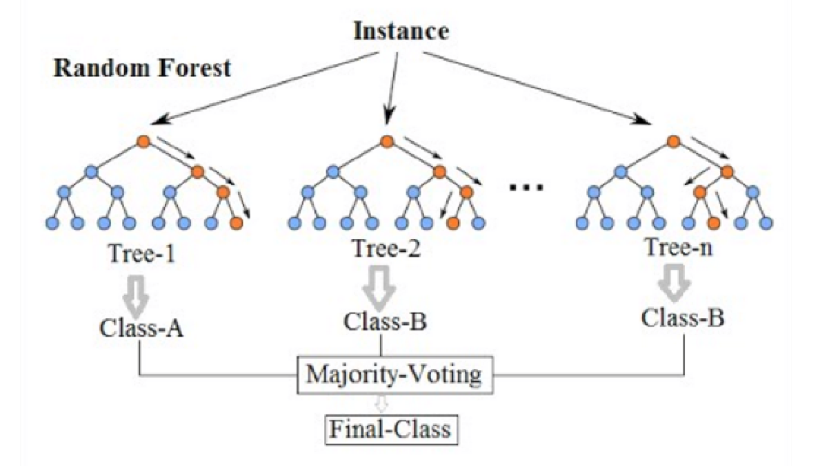
Fraud Algorithms
Random forest
An ensemble that combines predictions from multiple separate models.
Its purpose is to take advantage of the flexibility of decision tree, but also want to prevent them from overfitting training data.
Each tree considers a random subset of features (feature selection) and only has access to a random set of training data points (resampling).
Each tree is a strong learner and relatively unconstrained.
All the trees are trained in parallel and combined to smooth out prediction.

Slide 24
7
Results

Slide 25
Results
The performance metrics of each mode:
Among the 4 supervised learning models we built, Boosted Trees gave us the best results.
And the parameter is:
Max depth = 4
estimators = 100
Min samples leaf = 8
Model | Training | Test | Out of time
Log Reg | 0.5830 | 0.5323 | 0.4904
Random Forest | 0.5439 | 0.5228 | 0.4823
Decision Tree | 0.5739 | 0.5931 | 0.4127
Boosting | 0.5204 | 0.5332 | 0.4930

Slide 26
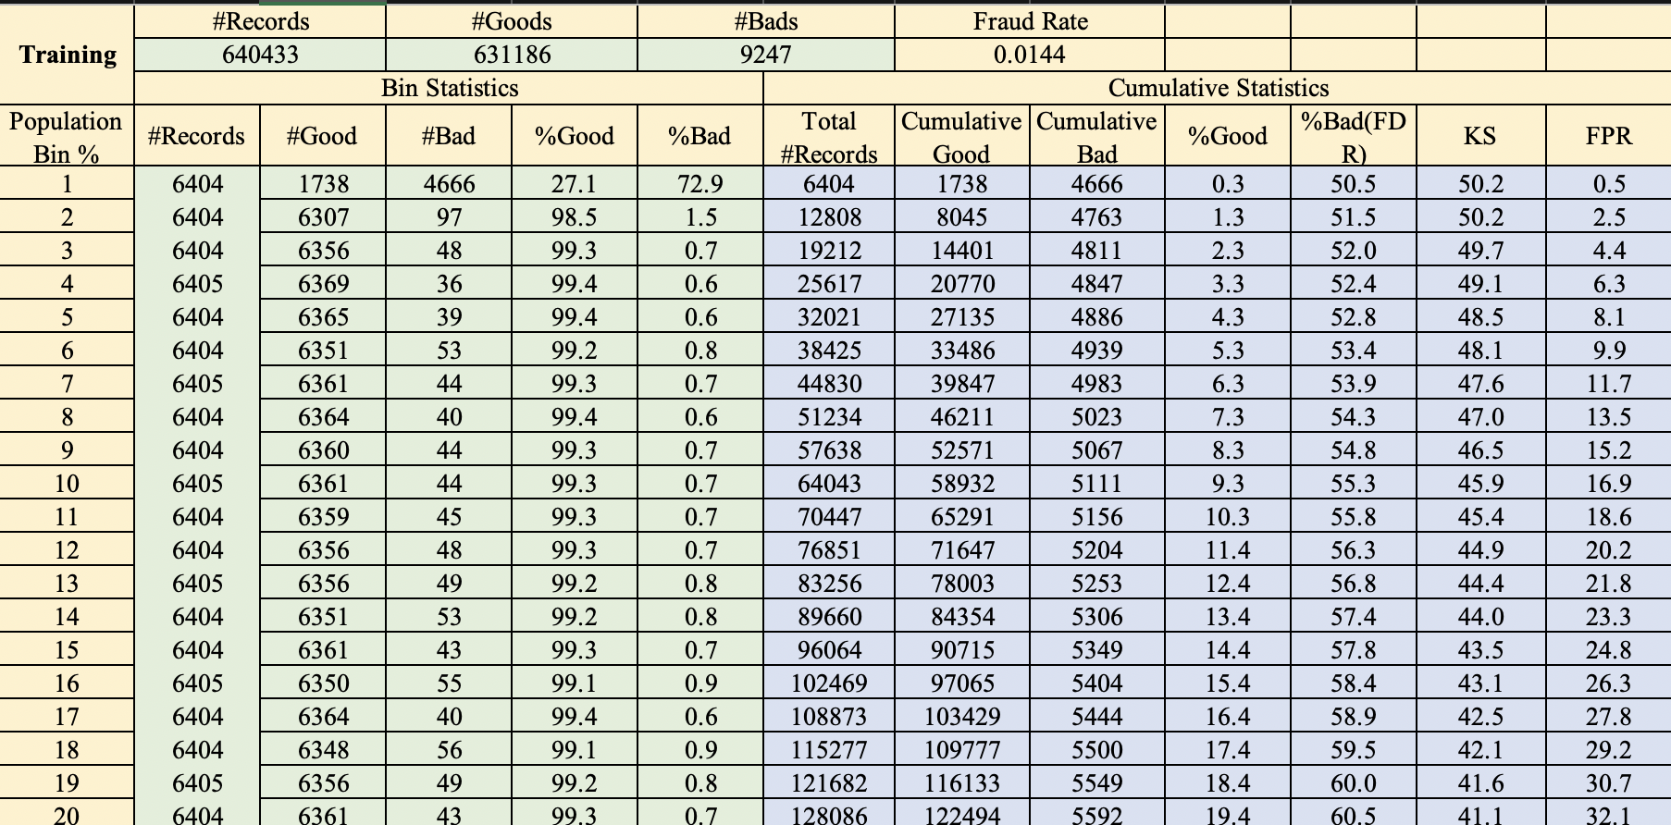
Training

Slide 27
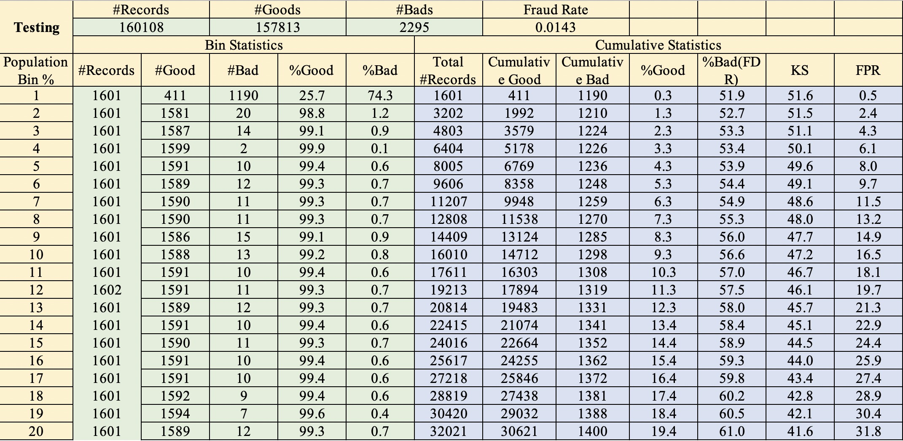
Testing

Slide 28
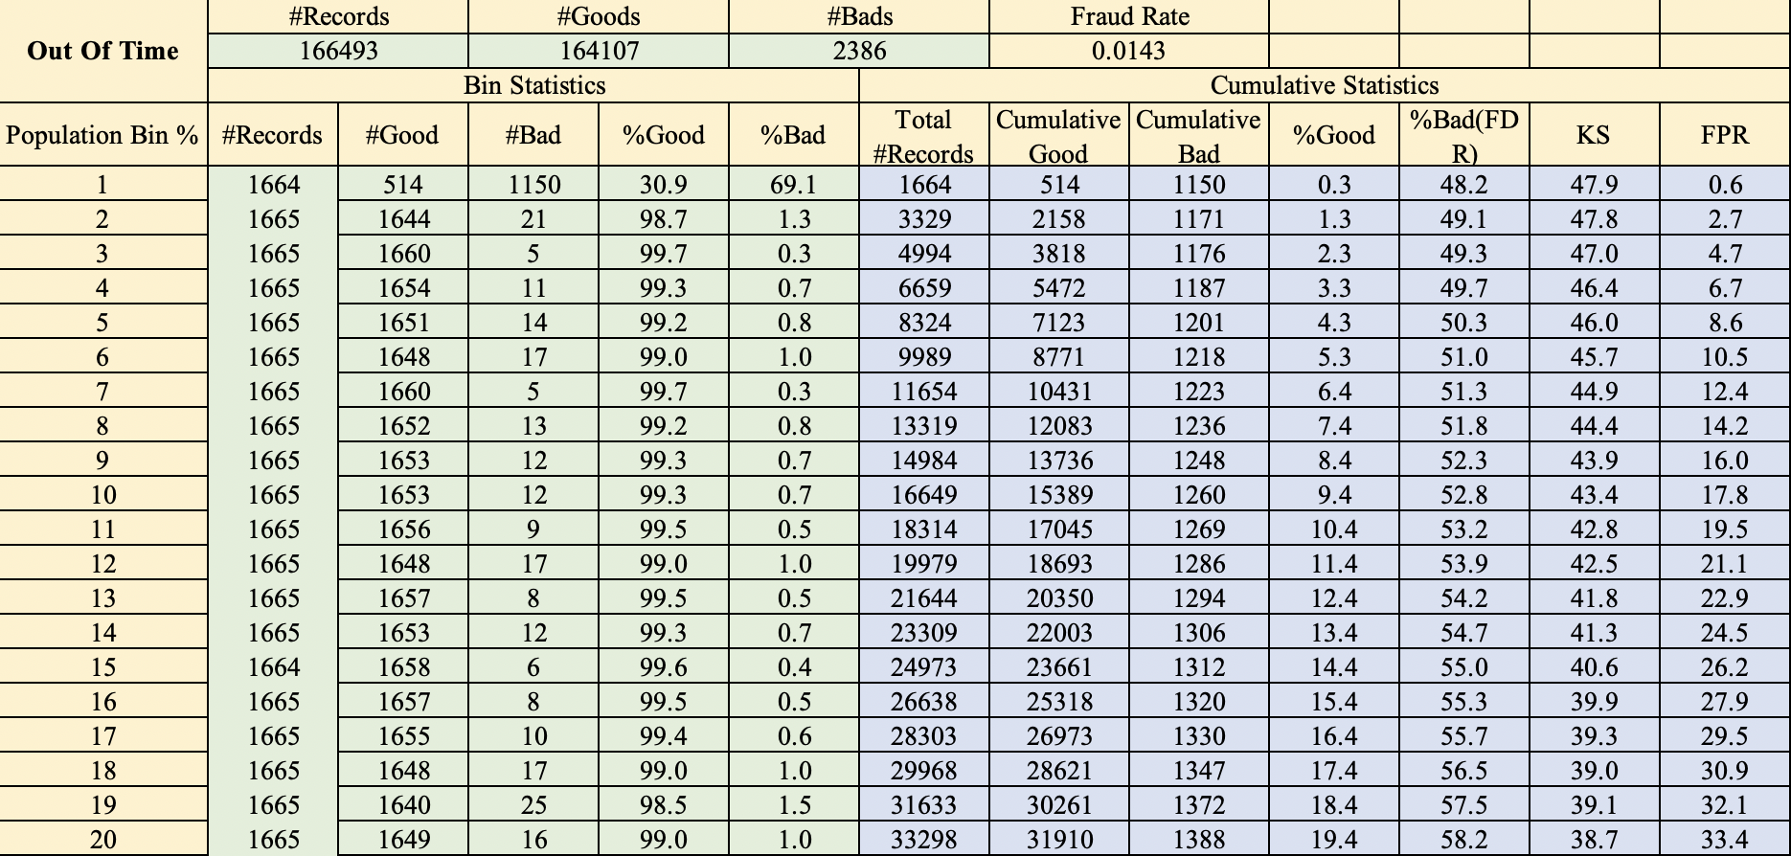
Out-of-time

Slide 29
8
Conclusion

Slide 30
Conclusion
First a detailed data quality report is made to find the type and value distribution of each variable
Then, data cleaning is conducted with R, to filter and get rid of frivolous field data.
After the cleaning, 310 expert variables are based on different time windows.
We divided the dataset into training, testing (January to October) and out-of-time (November and December) to do feature selection and model building.
KS score and FDR score are calculated first to get the first 200 ranking features, then backward wrapper is conducted to condense the subset of variables, from 200 to 100, 100 to 50, then 50 to 25 for future modeling.
The algorithms used for modeling are Decision Trees, Random Forest, Boosted Trees and Logistic Regression. We run them with our training(randomly select 80% from the Intime data), testing (remaining 20% from the Intime data) and out-of-time data.
Among all the models built, Boosting trees shows the best performance. The Average FDR at 3% is 49.3% average over 10 times.

Slide 31



Thank you for listening
Thank you for listening

